Slide 1
The Technical SEO Audit
Rick Ramos | seOveflow

Slide 2
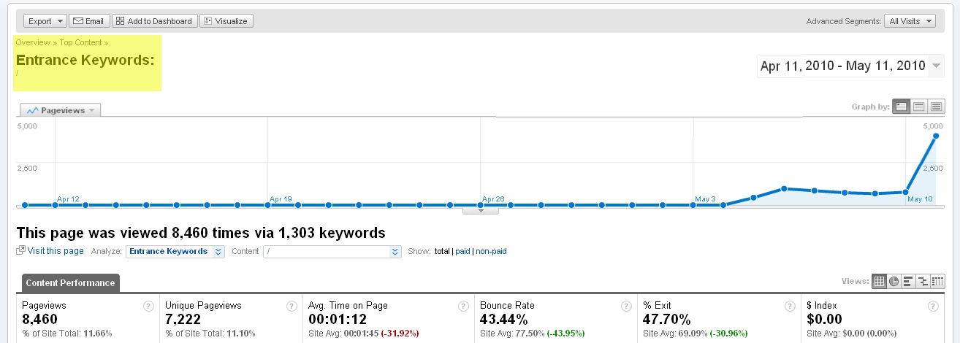
Introduction
SEO is search engine usability.
Why do you need an audit?
How nimble are your development resources?

Slide 3
Agenda
Code & Crawlability
Indexation
Website Crawl
Duplicate Content
Robots Access
Information Architecture
Microformatting & Rich Snippets
Brand
Keyword analysis
Content and Copywriting
Link analysis

Slide 4
How Search Engines Think
Academic Thesis
Mechanics
Topical Relevance
References
outbound
inbound
internal
Search Engine Optimization
Code & Crawlability
Content
Links
outbound
Inbound
internal

Slide 5
Code & Crawlability
A healthy foundation will encourage strong organic growth

Slide 6
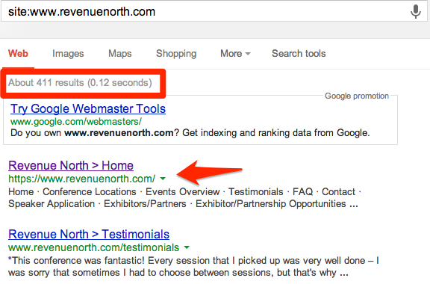
Indexation
site:search
Notes:
How many URLs are indexed?
Does the home page show up first

Slide 7
Indexation
site:search

Slide 8
Indexation
site:search

Slide 9
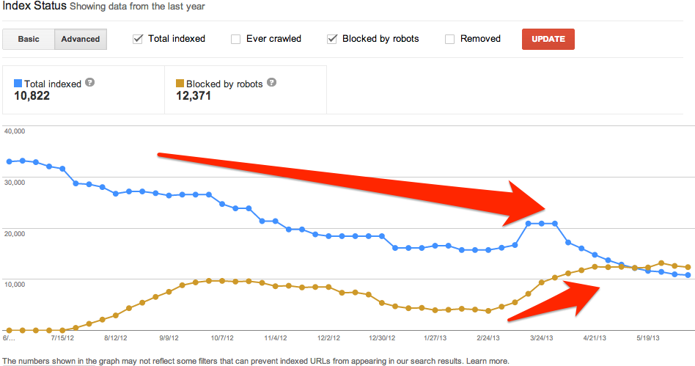
Indexation
Google Webmaster Tools

Slide 10
Website Crawl

Slide 11
Website Crawl
http://www.screamingfrog.co.uk/seo-spider/
Crawl Errors and Warnings
Information Architecture
Navigation
moz.com

Slide 12
Website Crawl
Response Codes
200 Found (Success)
301 Moved Permanently (Redirection)
302 Found (Redirection)
404 Not Found (Client Error)
5xx Server Errors
Duplicate and Missing HTML Title Tags
Titles Longer Than 70 Characters
Duplicate and Missing Meta Descriptions
Meta Descriptions Longer Than 160 Characters
Duplicate Page Content

Slide 13
Duplicate Content
Notes:
Define duplicate content penalty
Google chooses one version – highest authority
Importance of uniqueness

Slide 14
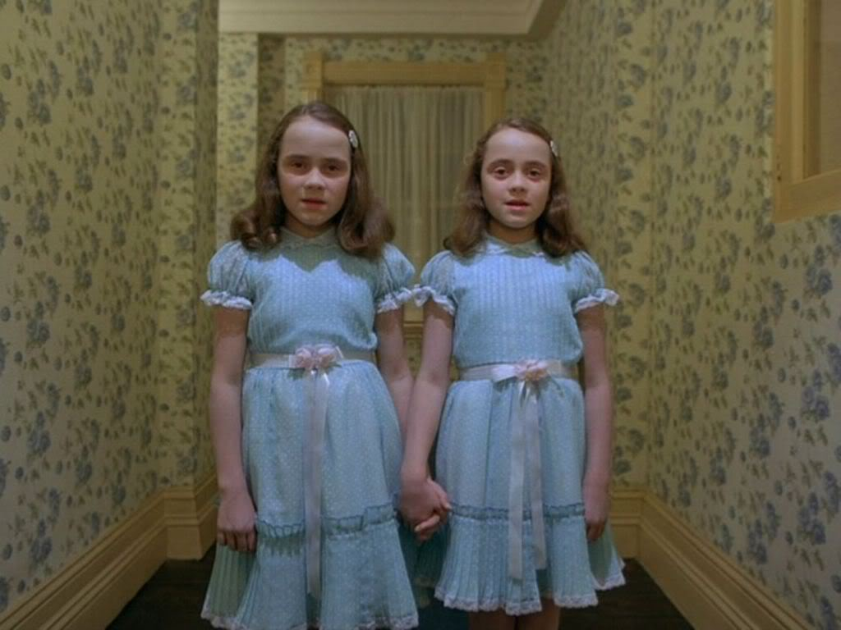
Types of Duplicate Content
Crawl Duplicates
Documents that are being duplicated by URL variants.
Typically resolved by adding robot directives.

Slide 15
Types of Duplicate Content
Crawl Duplicates
Architectural Duplicates
Documents that are duplicated by category pathways in the URL.
Commonly seen in blogs and eCommerce.
Typically resolved by removing category paths on some URLs.

Slide 16
Types of Duplicate Content
Crawl Duplicates
Architectural Duplicates
Off-Site Duplicates
Duplicate content that appears on other domains/sub-domains
Must be resolved at the other location

Slide 17
Robots Access
Notes:
Guide the robots
Txt file Crawl suggestions, not indexation
Meta robots for inxexation

Slide 18
Robots Access
Crawl Duplicates

Slide 19
Robots Access
Disallow: *?rc=*
<link rel="canonical" href="http://www.example.com/management-team.html"/>

Slide 20
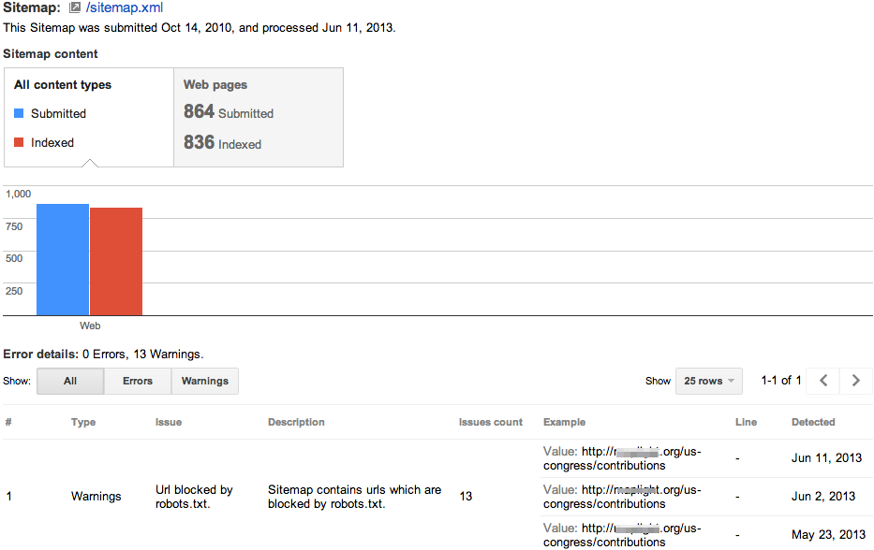
XML sitemap
Guidelines for Sitemaps
No more than 50,000 URLs and must be no larger than 50MB
Specify all URLs using the same syntax (www vs. non-www)
Sitemap URLs must return a 200 Found status code

Slide 21
Information Architecture and Navigation

Slide 22
Navigational Duplicates
Notes:
Where do you place a Disney Cruise?

Slide 23
Navigational Duplicates
www.travelexperience.com/disney-vacations/disney-cruise/
www.travelexperience.com/cruises/disney-cruise/
www.travelexperience.com/luxury-getaways/disney-cruise/
www.travelexperience.com/family-vacations/disney-cruise
www.travelexperience.com/vacations/disney-cruise
www.travelexperience.com/disney-vacations/
www.travelexperience.com/cruises/
www.travelexperience.com/luxury-getaways/
www.travelexperience.com/family-vacations/

Slide 24
Microformatting & Rich Snippets

Slide 25
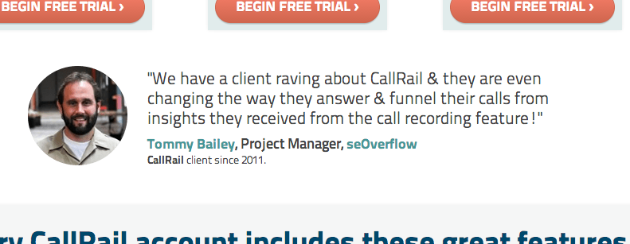
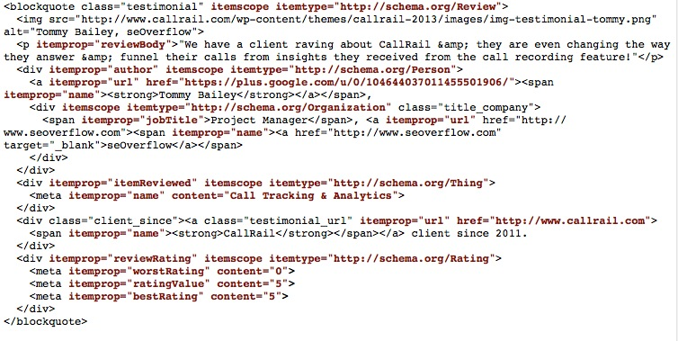
Microformatting & Rich Snippets

Slide 26
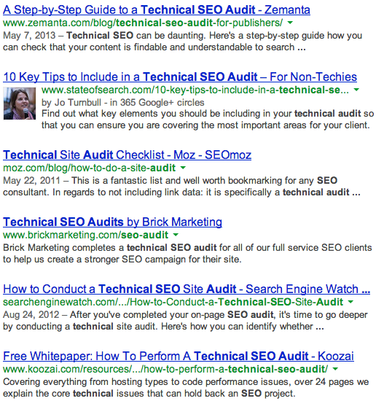
Microformatting & Rich Snippets
rel=author
rel=publisher
Notes:
Publisher snippets work in testing currently

Slide 27
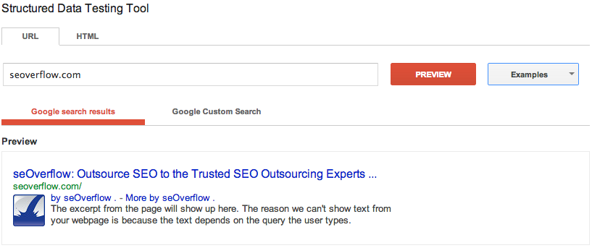
Microformatting & Rich Snippets
rel=author
rel=publisher
Notes:
By seOverflow = Google+ brand page
More By = Google SERP results published by seOverflow

Slide 28
Additional Technical On-Page Factors
HTML Sitemap
Browser Compatibility
Malware
Black-Hat SEO
Hidden text
JavaScript elements
Dynamic page generation
Page Load Speed
Mobile Friendliness
Analytics & Conversion Tracking

Slide 29
Brand

Slide 30
Brand
Notes:
Does your website appear first?
What else does it display?

Slide 31
Brand
Notes:
How does that compare to your competition?

Slide 32
Brand
Notes:
How do other brand-related terms look?

Slide 33
Keyword Analysis

Slide 34
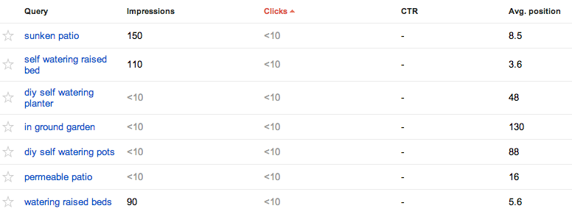
Keyword Analysis
Google Webmaster Tools
Traffic > Search Queries

Slide 35
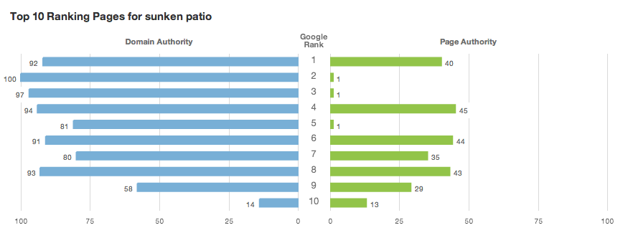
Keyword Analysis
MOZ.com Keyword Difficulty Report

Slide 36
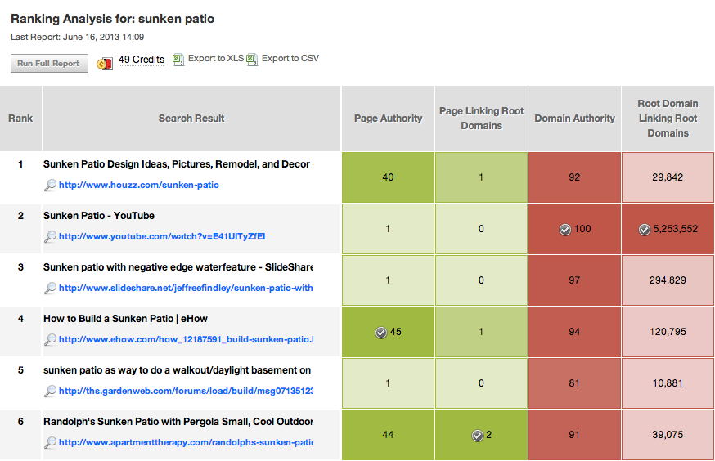
Keyword Analysis
MOZ.com Keyword Difficulty Report

Slide 37
Content & Copywriting
Notes:
Content is King

Slide 38
Content & Copywriting
Compelling and optimized copy on every page
Content containing keywords, but not over done
Unique, optimized title tags - under 65 characters
Compelling meta descriptions under 155 characters, containing calls to action
Strategic internal linking
Image alt text and file names optimized
Notes:
at least 3 pages (home, category, post, product)
H-tags
Internal linking

Slide 39
Link Analysis

Slide 40
Link Analysis
Open site Explorer

Slide 41
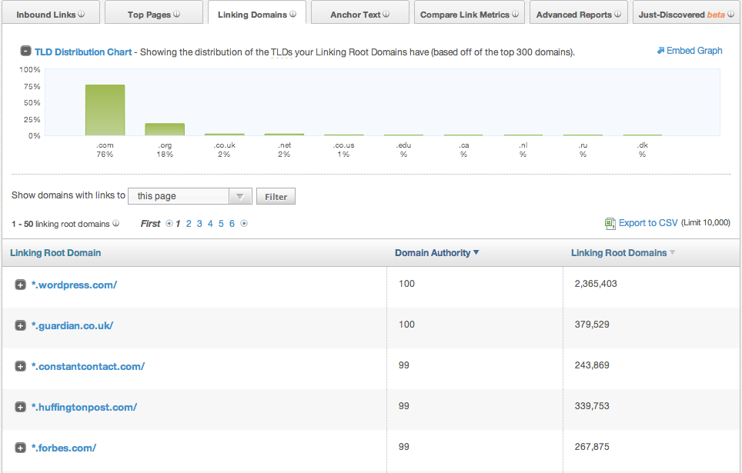
Link Analysis
Open site Explorer
Notes:
Go through tabs at the top

Slide 42
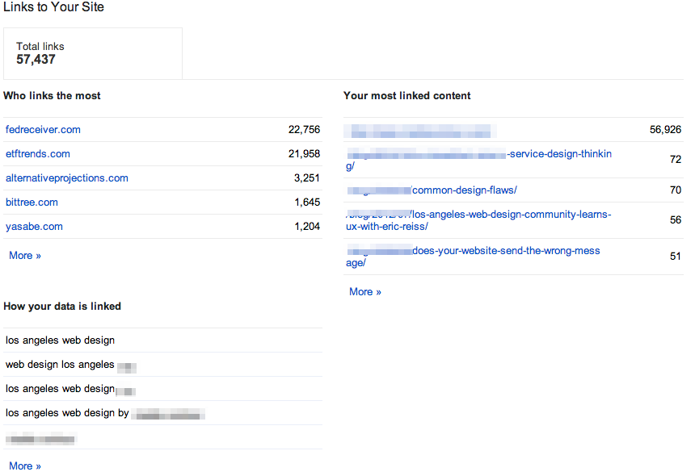
Link Analysis
Google Webmaster Tools

Slide 43
The Technical SEO Audit
Rick Ramos
@Trypnotik
seOverflow
rick@seoverflow.com
http://www.linkedin.com/in/trypnotik

